Slide 1
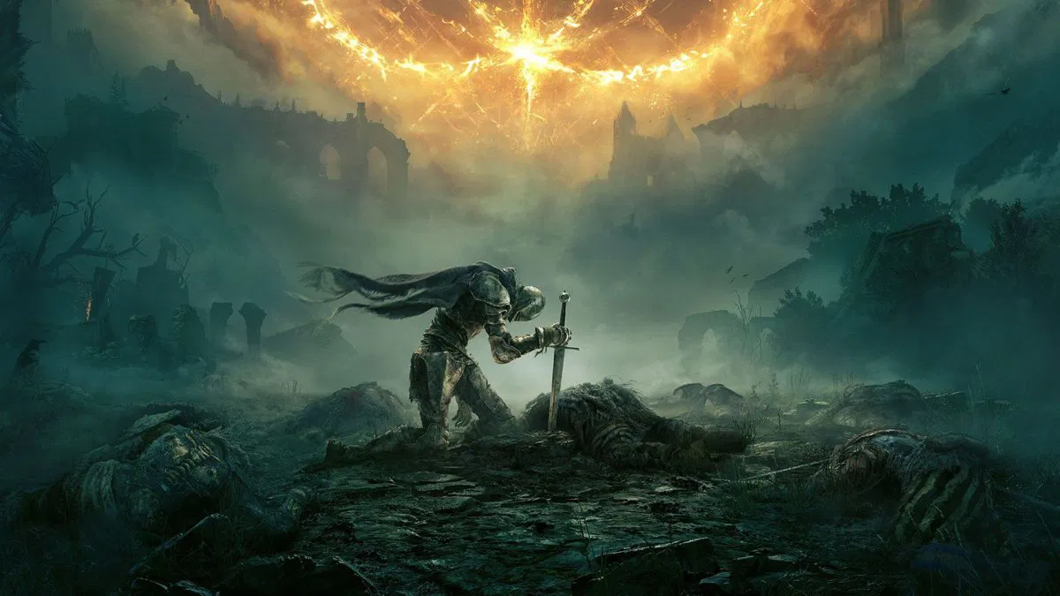
Elden Ring
Patrik Schneider
Notes:
Hello, everyone! Today I will be talking about a famous video game called Elden Ring. It is an soulslike game developed by FromSoftware and published by Bandai Namco Entertainment. It was released in February 2022 and became very popular worldwide. In this presentation, I will explain the story, gameplay, and the reasons why Elden Ring is so special.

Slide 2
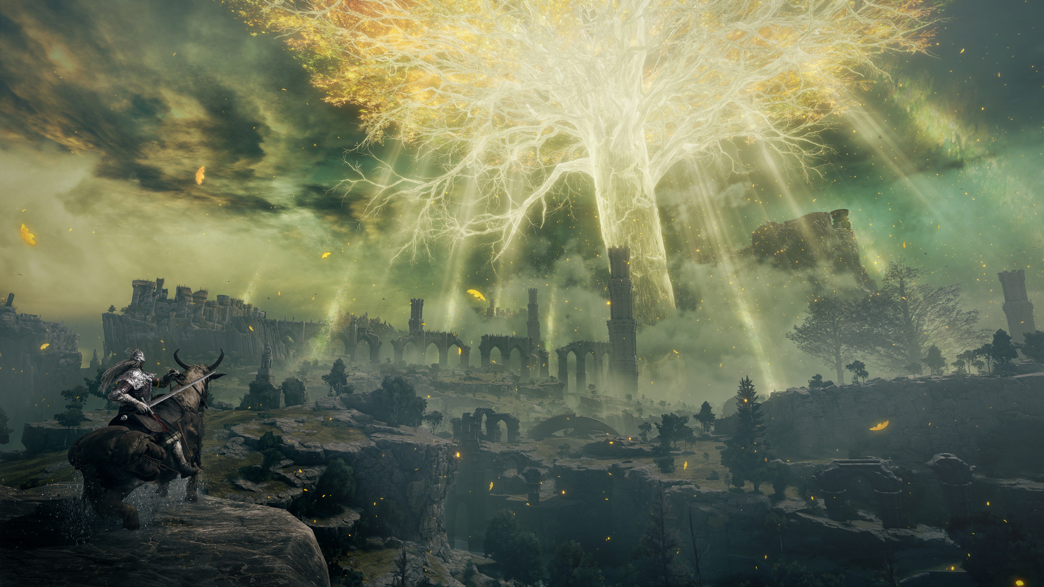
Story of Elden Ring
The game is set in a world called „The Lands Between“
Main character
What is Elden Ring?
Notes:
The game is set in a world called "The Lands Between".
The main character, the "Tarnished", is on a quest to find the pieces of the Elden Ring.
The Elden Ring is a powerful object that has been broken, causing chaos in the world.
The player meets many characters and must fight powerful enemies to become the Elden Lord.

Slide 3
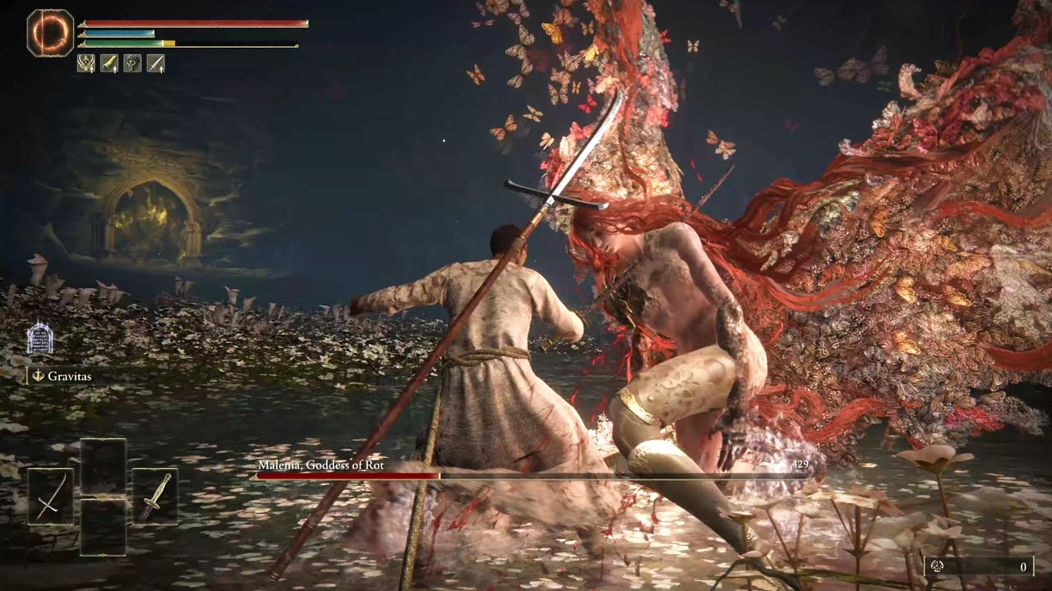
Gameplay
Open-world game
RPG elements
Notes:
Elden Ring is an open-world game which is not so usual with soulslike games
Players can explore vast landscapes freely.
The game focuses on combat, with weapons, magic, and abilities.
RPG elements: leveling up, choosing classes, and customizing abilities.

Slide 4
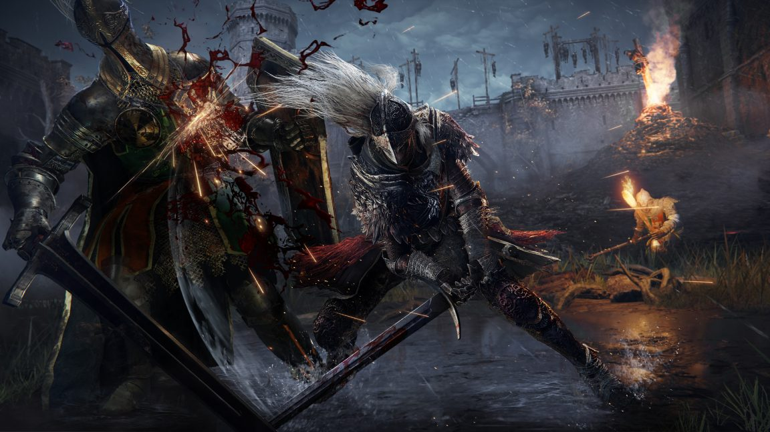
Difficulty and Challenge
Bosses
Strategy and learning from mistakes
Notes:
Elden Ring is known for its difficulty.
Players must carefully plan their strategy and learn from mistakes.
The game is challenging but rewarding, requiring patience and skill.
The bosses are especially tough and require special tactics.

Slide 5
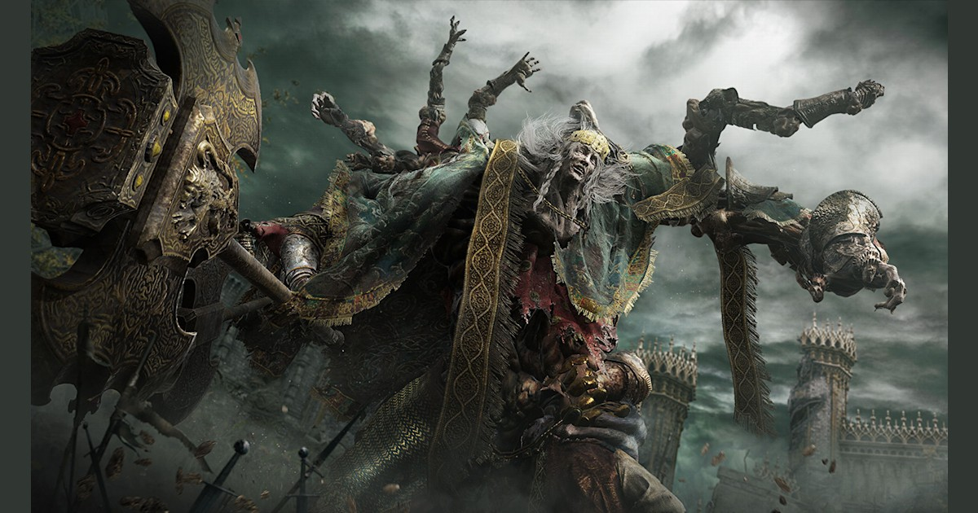
Artistic Design and Graphics
Dark fantasy
Unique and beatiful landscapes
Impressive graphics and special effects
Notes:
The world of Elden Ring has beautiful, detailed environments.
The design combines dark fantasy with beautiful landscapes.
Characters and enemies have unique and creative designs.
The game features impressive graphics and special effects.

Slide 6
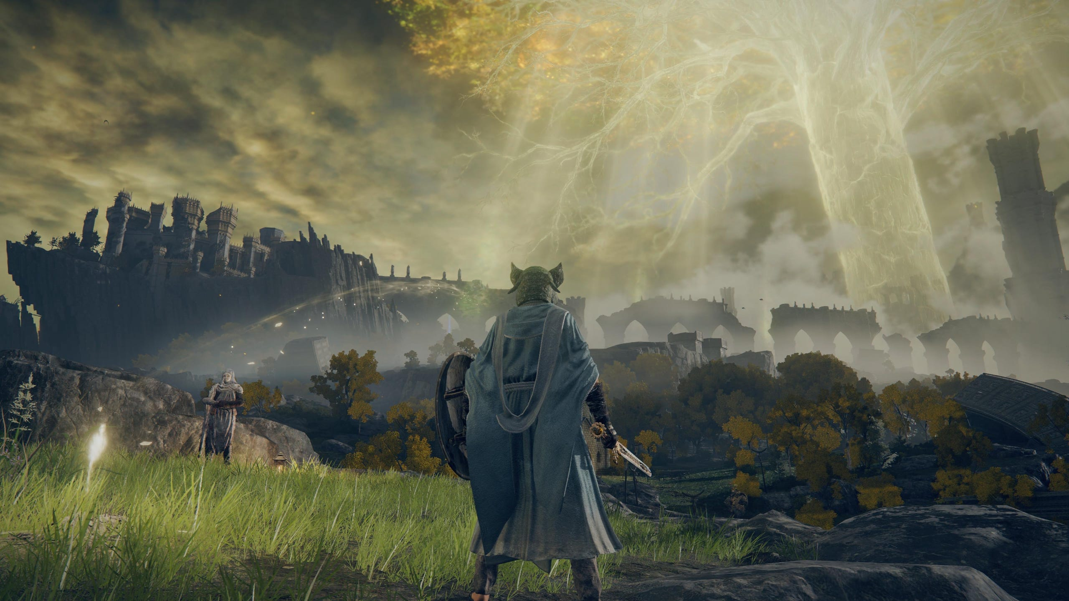

Slide 7
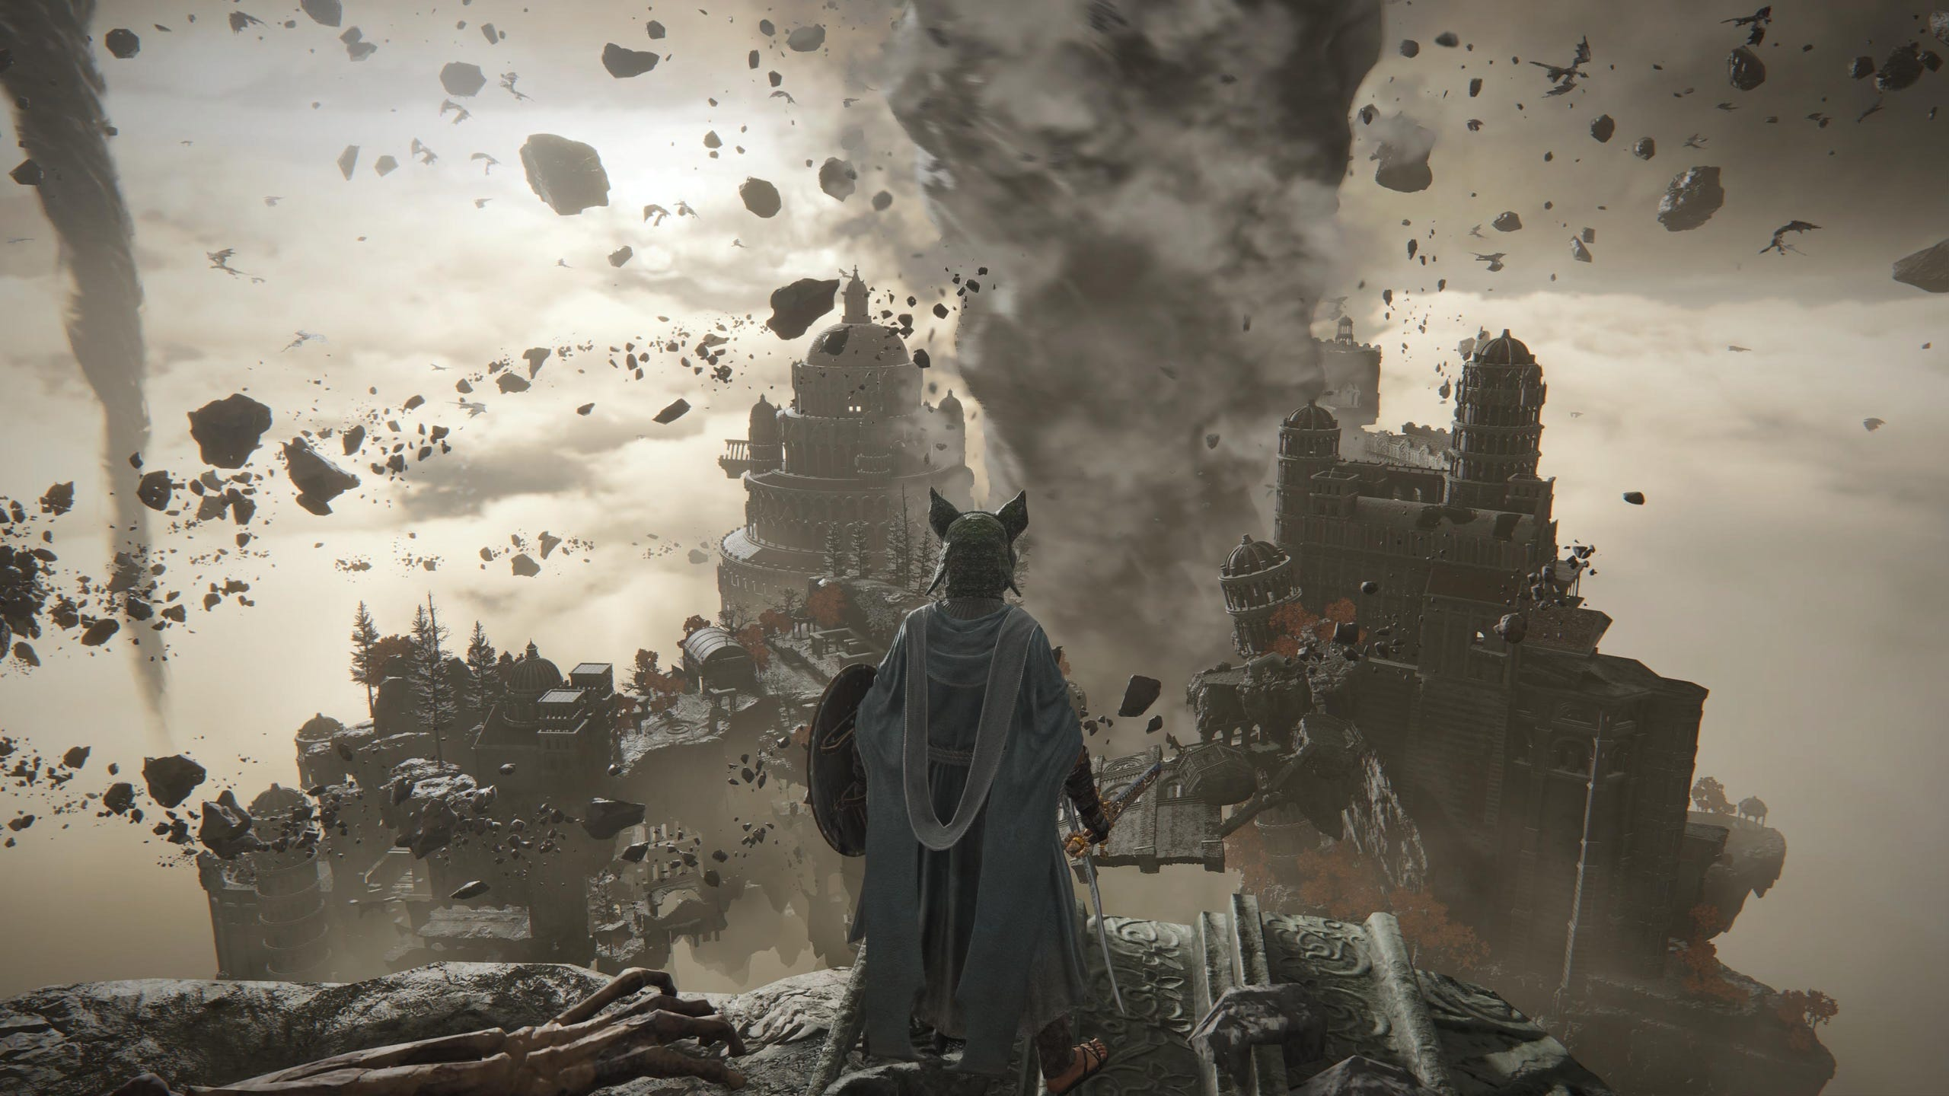

Slide 8
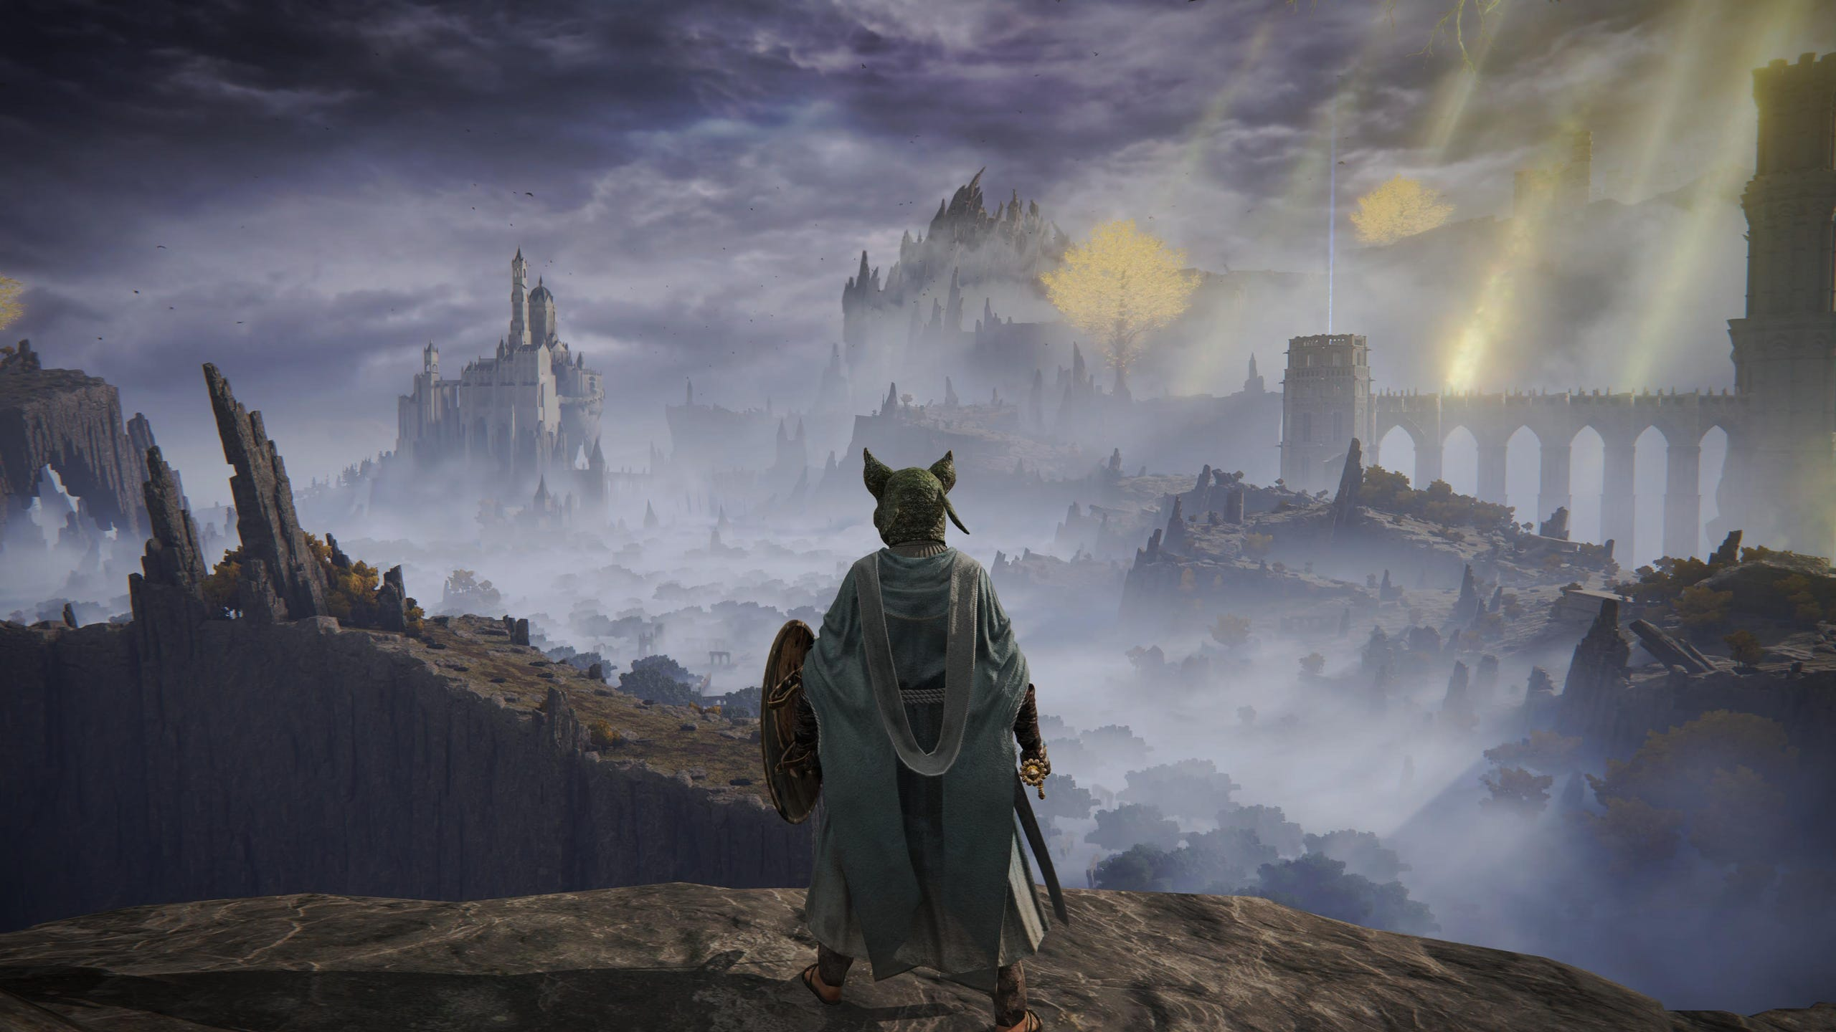

Slide 9
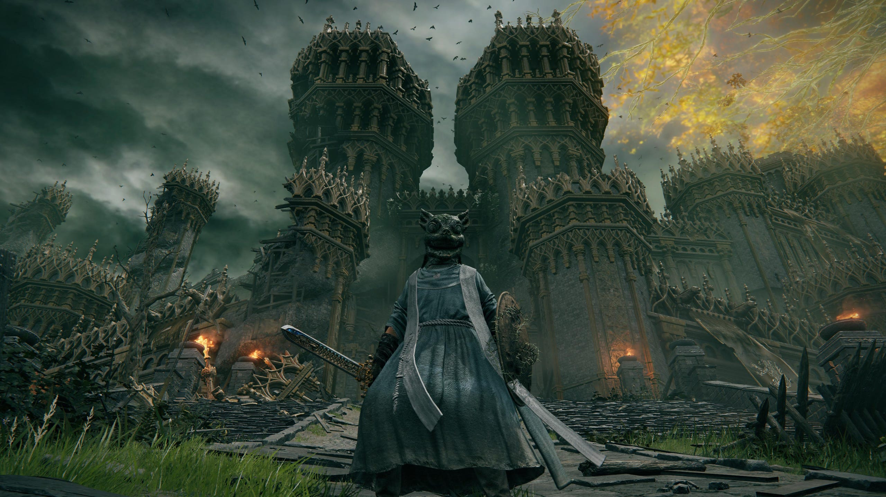

Slide 10
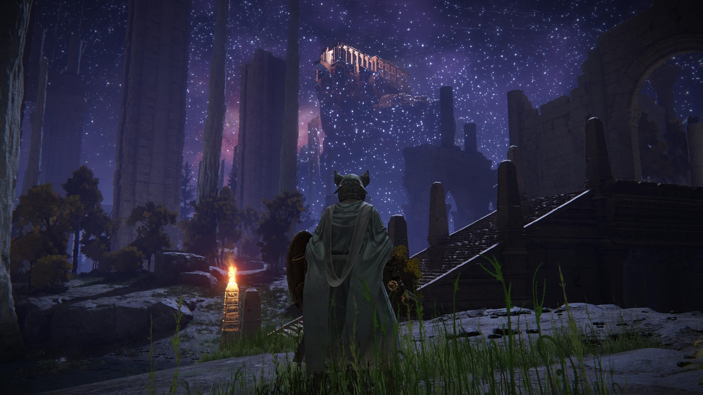

Slide 11
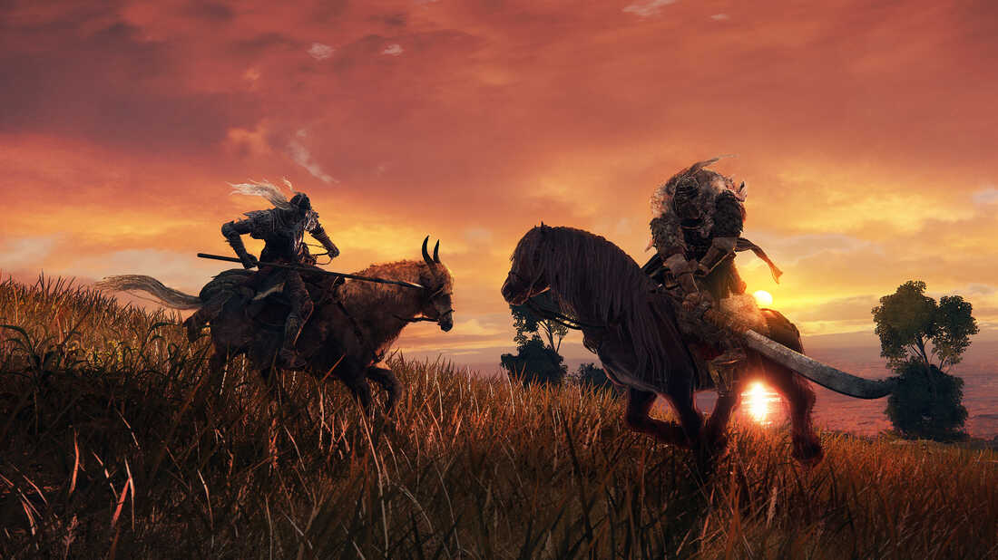
Why Elden Ring is so Special
Open World
Challenging Combat
Storytelling
Artistic World
Notes:
Open World: The freedom to explore and discover new things.
Challenging Combat: The difficulty makes it exciting and rewarding.
Storytelling: The deep story and rich lore.
Artistic World: Stunning visuals and unique design.

Slide 12
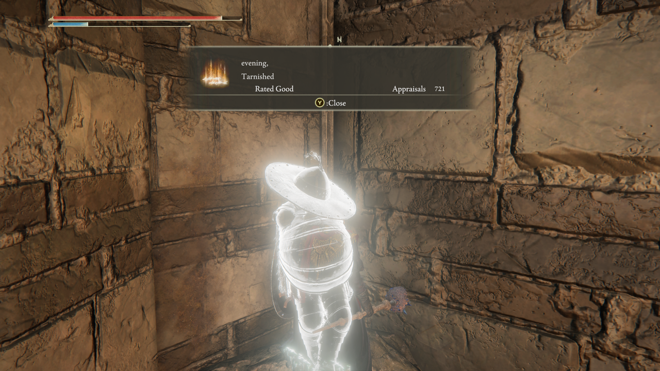
Thank you fo your attention!!

Slide 13
Sources:
chat.com
https://www.cgmagonline.com/review/game/elden-ring-pc-review/
https://ftw-eu.usatoday.com/story/tech/gaming/2022/04/18/elden-ring-most-beautiful-locations/81338848007/
https://font.download/font/optimus-princeps
https://cs.wikipedia.org/wiki/D%C3%ADlo#cite_note-1
https://www.ign.com/articles/elden-rings-player-messages-fascinating-social-media-platform-2022

